Slide 1
Powerchain
Democratizing the energy market

Slide 2
Agenda
What is blockchain?
Blockchain in the energy market
Market outlook
Our proposal

Slide 3
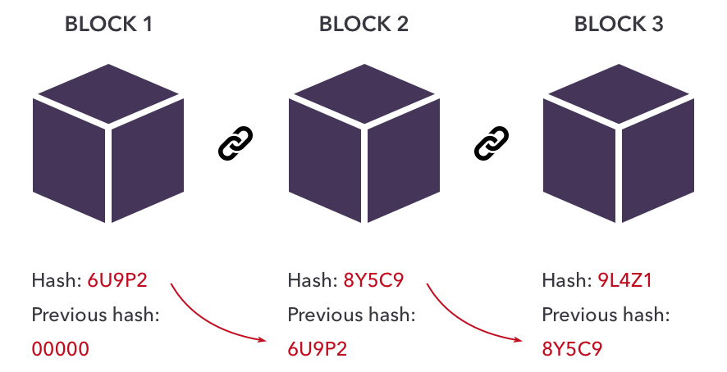
What is blockchain?

Slide 4
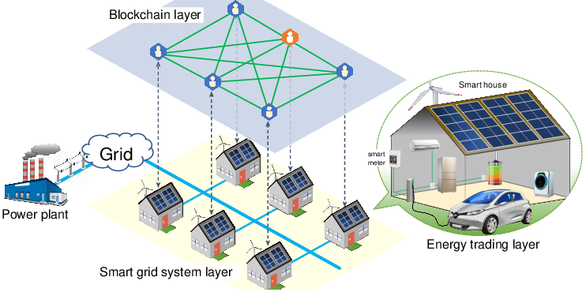
Blockchain in the energy sector

Slide 5

Market outlook

Slide 6

Our proposal
Notes:
AI smart contract
Buy and sell electricity
Electrical installations with battery
DB <=> Backend <=> Frontend
https://wireframe.cc/pro/pp/2a05c6c66469229

